Slide 1
Where is my Code Vulnerable: Matching CVEs and Source Code
David A. Barrett & Peter Shin, Canvass Labs
david.barrett@canvasslabs.com
peter@canvasslabs.com
https://www.canvasslabs.com

Slide 2

Motivation
Modern software depends upon third-party or open source software (or prior versions of their own proprietary software)
Introduces maintenance costs for developers
(or security officers)
Track dependencies
Monitor dependencies
for newly-discovered vulnerabilities
Apply patches for updates
2

Slide 3
Solution
Create Databases:
- Find vulnerable code in open source
- Find package names/versions in NVD
Scan your source code to find vulnerabilities
Report the vulnerable code and its fix.
3

Slide 4
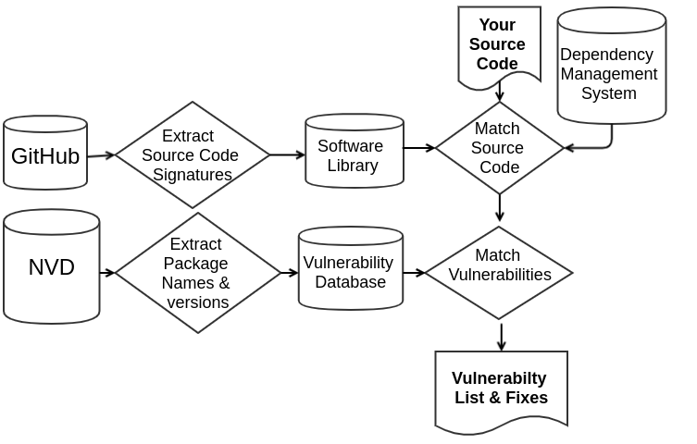
Flow Diagram: Finding Vulnerable Code
4

Slide 5
Map NVD Description to Package Names and Versions
5

Slide 6
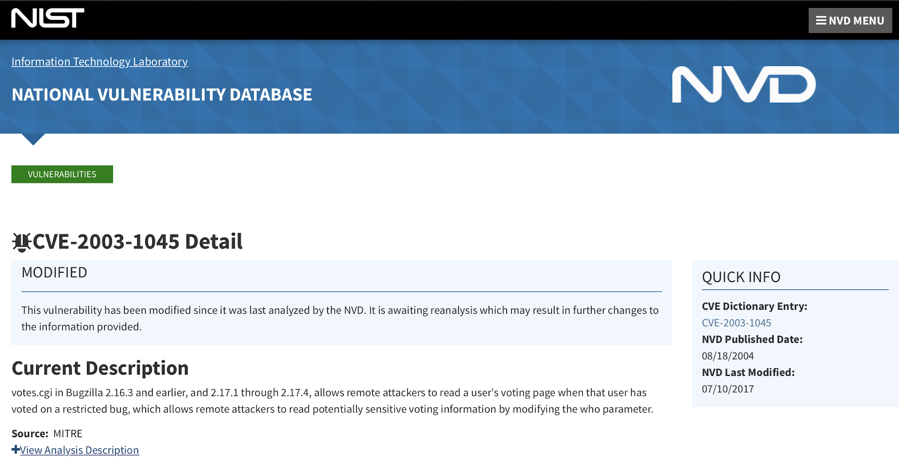
Mapping NVD Description (example)
6

Slide 7
CVE-2003-1045 Description
votes.cgi in Bugzilla 2.16.3 and earlier, and 2.17.1 through 2.17.4, allows remote attackers to read a user's voting page when that user has voted on a restricted bug, which allows remote attackers to read potentially sensitive voting information by modifying the who parameter.
7

Slide 8
Keyword Tagging
Bugzilla
2.16.3
and
earlier
,
and
2.17.1
through
2.17.4
product name (pn)
version range end (vre)
=
<
separator (sp)
separator (sp)
version range start (vrs)
<=
version range end (vre)
8

Slide 9
Keyword Interpretation
Bugzilla <= 2.16.3
and
2.17.1 <= Bugzilla <= 2.17.4
2.0
2.16.3
2.17.1
2.17.4
Bugzilla
9

Slide 10
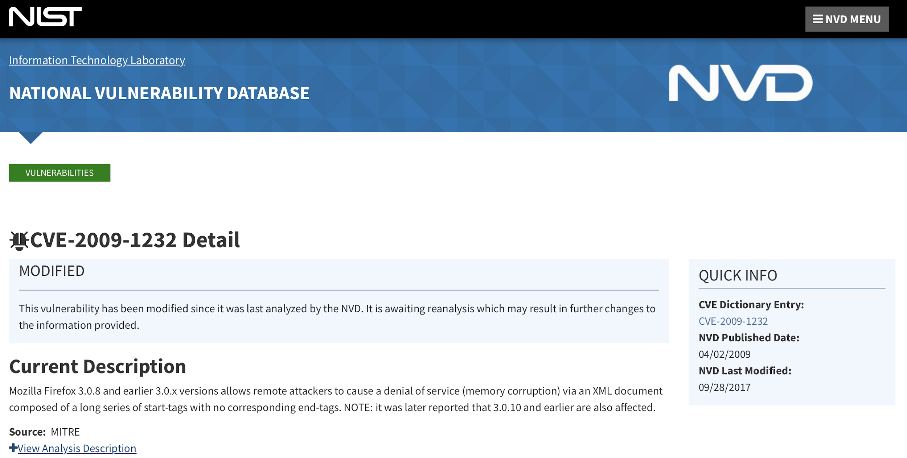
Example 2
10

Slide 11
CVE-2009-1232 Description
Mozilla Firefox 3.0.8 and earlier 3.0.x versions allows remote attackers to cause a denial of service (memory corruption) via an XML document composed of a long series of start-tags with no corresponding end-tags. NOTE: it was later reported that 3.0.10 and earlier are also affected.
11

Slide 12
Keyword Tagging (example 2)
Mozilla Firefox 3.0.8 and earlier 3.0.x
. . .
3.0.10 and earlier
pn pn vre = < vr
vre = <
12

Slide 13
Keyword Interpretation (example 2)
3.0.x <= Mozilla Firefox <= 3.0.8
and
Mozilla Firefox <= 3.0.1
1.0
3.0.1
3.0.0
3.0.8
Mozilla Firefox
13

Slide 14
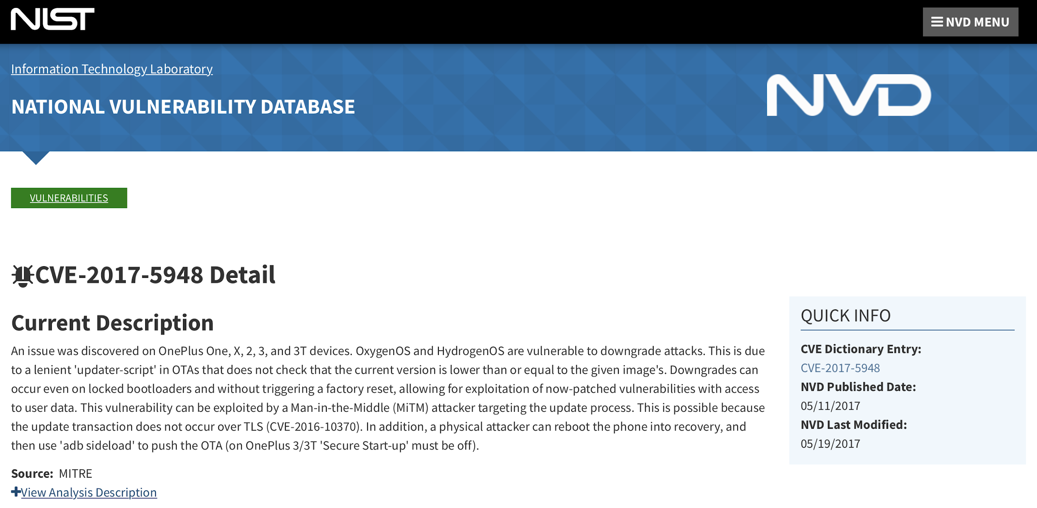
Example 3
14

Slide 15
CVE-2017-5948 Description
An issue was discovered on OnePlus One, X, 2, 3, and 3T devices. OxygenOS and HydrogenOS are vulnerable to downgrade attacks. This is due to a lenient 'updater-script' in OTAs that does not check that the current version is lower than or equal to the given image's. Downgrades can occur even on locked bootloaders and without triggering a factory reset, allowing for exploitation of now-patched vulnerabilities with access to user data. This vulnerability can be exploited by a Man-in-the-Middle (MiTM) attacker targeting the update process. This is possible because the update transaction does not occur over TLS (CVE-2016-10370). In addition, a physical attacker can reboot the phone into recovery, and then use 'adb sideload' to push the OTA (on OnePlus 3/3T 'Secure Start-up' must be off).
15

Slide 16
Keyword Tagging (example 3)
OnePlus One , X , 2 , 3 , and , 3T
. . .
OxygenOS and HydrogenOS
pn pn sp pn sp pn sp pn sp sp sp pn
pn sp pn
16

Slide 17
Keyword Interpretation (example 3)
Vulnerable products:
OnePlus One X
OnePlus One 2
OnePlus One 3
OnePlus One 3T
OxygenOS
HydrogenOS
17

Slide 18
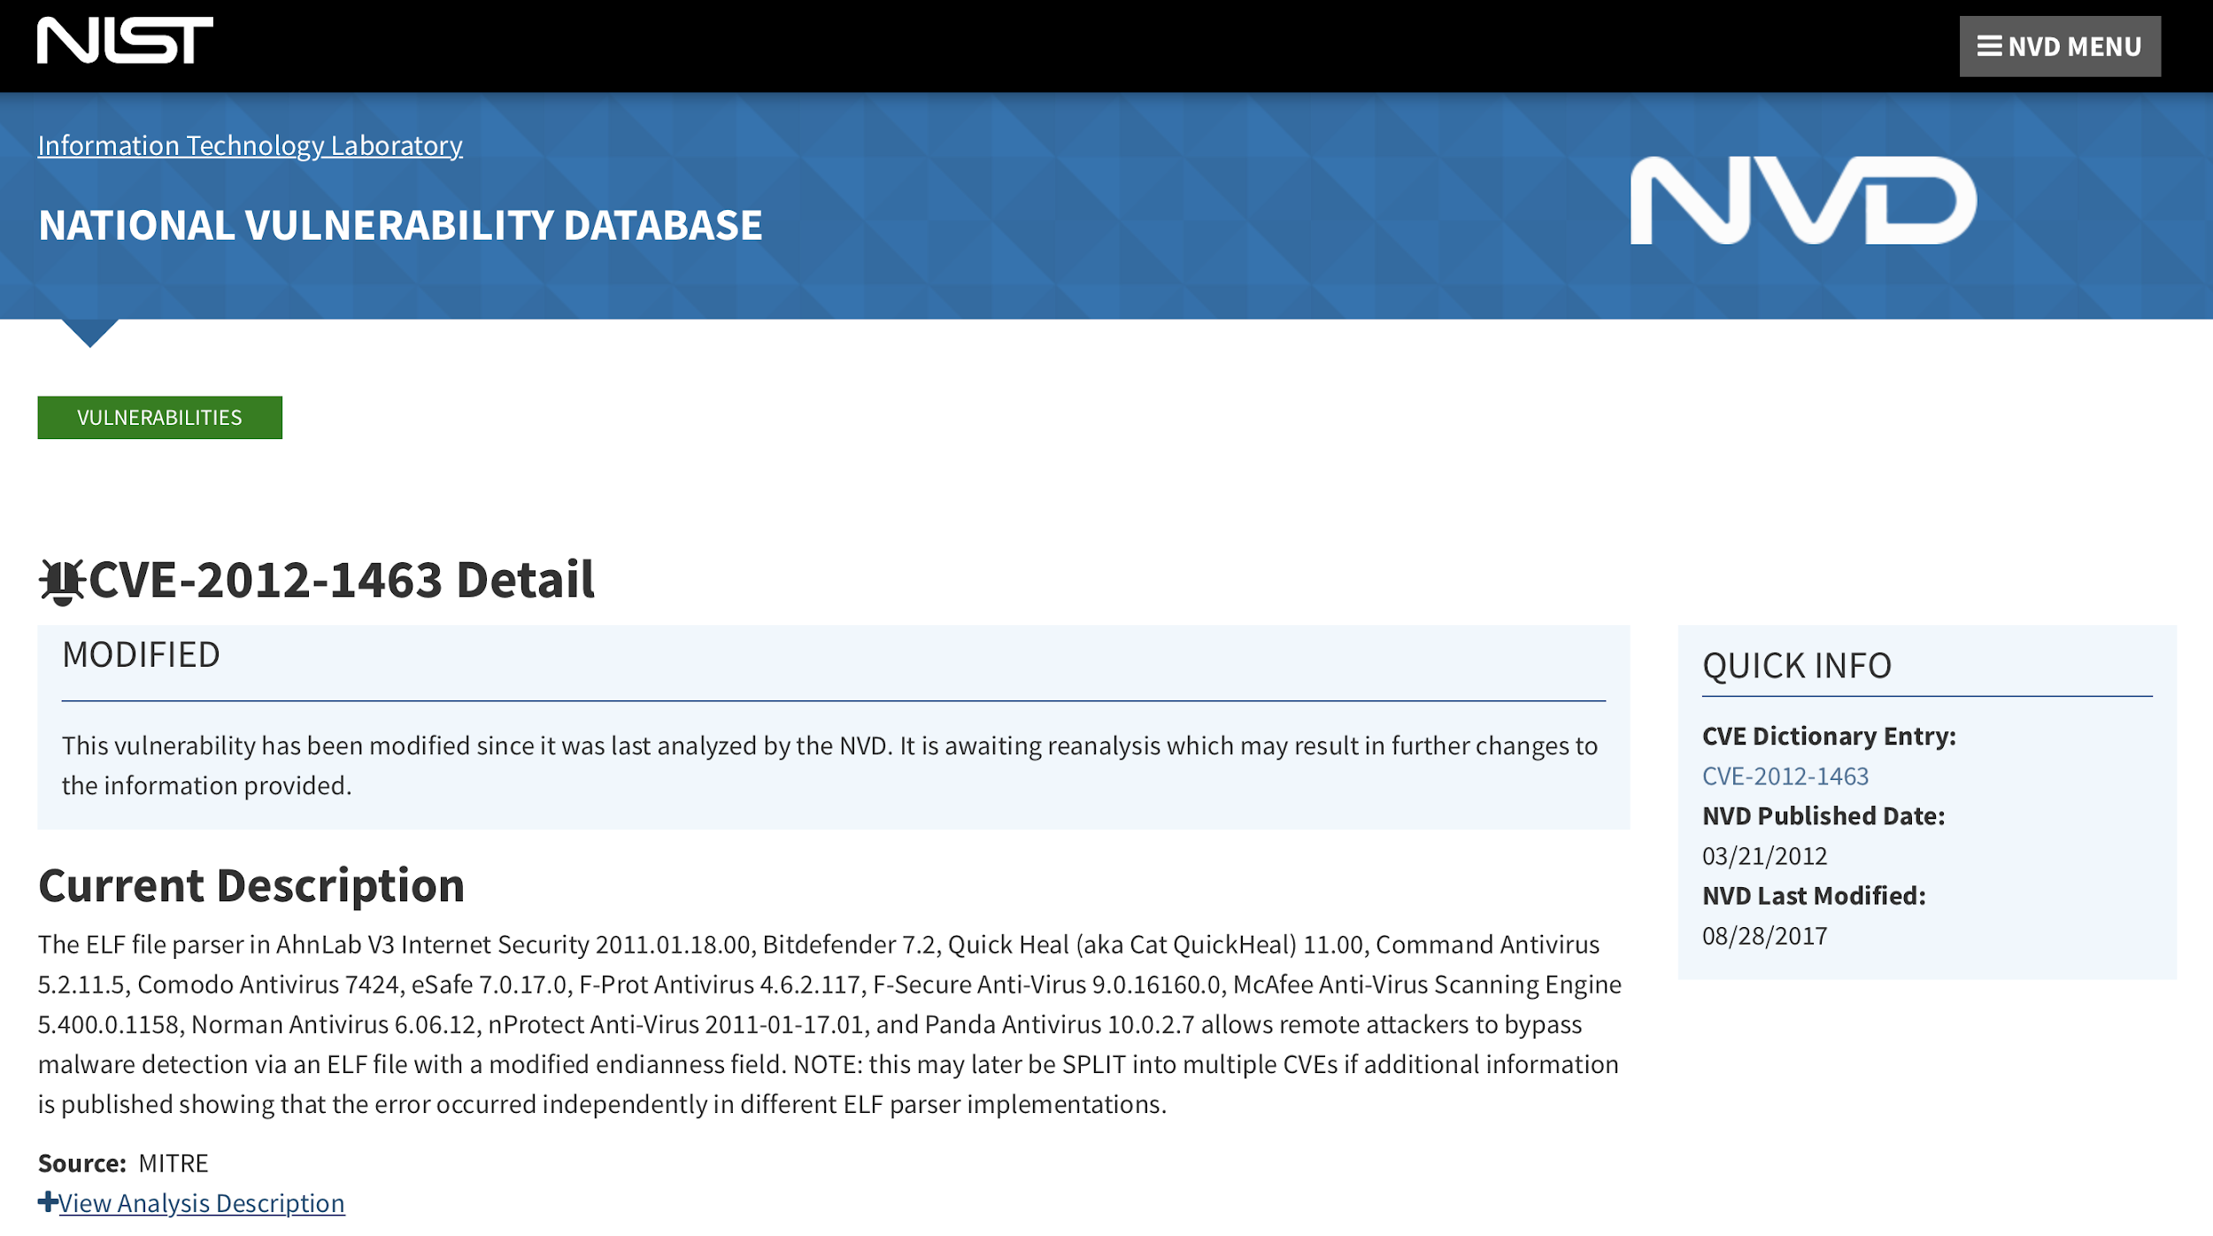
Example 4
18

Slide 19
CVE-2012-1463 Description
The ELF file parser in . . . Command Antivirus 5.2.11.5, Comodo Antivirus 7424, eSafe 7.0.17.0, F-Prot Antivirus 4.6.2.117, F-Secure Anti-Virus 9.0.16160.0, McAfee Anti-Virus Scanning Engine 5.400.0.1158, Norman Antivirus 6.06.12, nProtect Anti-Virus 2011-01-17.01, and Panda Antivirus 10.0.2.7 allows remote attackers to bypass malware detection via . . .
19

Slide 20
Keyword Tagging (example 4)
Command Antivirus 5.2.11.5 , Comodo Antivirus 7424 , eSafe 7.0.17.0 , F-Prot Antivirus 4.6.2.117 , F-Secure Anti-Virus 9.0.16160.0 , McAfee Anti-Virus Scanning Engine 5.400.0.1158 , Norman Antivirus 6.06.12 , nProtect Anti-Virus 2011-01-17.01 , and Panda Antivirus 10.0.2.7
pn pn version sp pn pn
version sp pn version sp pn pn version sp
pn pn version sp pn pn
pn pn version sp pn pn
version sp pn pn version sp sp
pn pn version
20

Slide 21
Keyword Interpretation (example 4)
Command Antivirus 5.2.11.5
Comodo Antivirus 7424
eSafe 7.0.17.0
F-Prot Antivirus 4.6.2.117
F-Secure Anti-Virus 9.0.16160.0
McAfee Anti-Virus Scanning Engine 5.400.0.1158
Norman Antivirus 6.06.12
nProtect Anti-Virus 2011-01-17.01
Panda Antivirus 10.0.2.7
21

Slide 22
CVE-2006-0219 Description
The original distribution of MyBulletinBoard (MyBB) to update from older versions to 1.0.2 omits or includes older versions of certain critical files, which allows attackers to conduct (1) SQL injection attacks via an attachment name that is not properly handled by inc/functions_upload.php (CVE-2005-4602), and possibly (2) other attacks related to threadmode in usercp.php.
22

Slide 23
Finding Vulnerable Code
23

Slide 24
A Vulnerability and its Fix
Patch code:
Package: linux
File: kernel/bpf/verifier.c
CVE ID: CVE-2017-16995
Repository: /kernel
Function: check_alu_op
CWE_ID: CWD-119
24

Slide 25
Vulnerable Source Code
int check_alu_op(struct bpf_verifier_env* env ,
struct bpf_insn*_env insn) { struct bpf_reg_state *regs = cur_regs(env)
...
regs[insn->dst_reg].type = SCALAR_VALUE; __mark_reg_known(
regs + insn->dst_reg, insn->imm);
25

Slide 26
We Use its Abstract Syntax
TYPE check_alu_op(TYPE PARM,
TYPE PARM) { TYPE LOCAL_VAR = FUNC_CALL(PARM)
...
LOCAL_VAR[PARM] = SCALAR_VALUE; FUNC_CALL(
LOCAL_VAR + PARM, PARM);
26

Slide 27
Vulnerable Source Code
int check_alu_op(struct bpf_verifier_env* env ,
struct bpf_insn*_env insn) { struct bpf_reg_state *regs = cur_regs(env)
...
regs[insn->dst_reg].type = SCALAR_VALUE; __mark_reg_known(
regs + insn->dst_reg, insn->imm);
27

Slide 28
To Match Your Altered Source Code:
int check_alu_op(struct bpf_verifier_env* env ,
struct bpf_insn*_env my_insn) { struct bpf_reg_state *regs = cur_regs(env)
...
regs[my_insn->dst_reg].type = SCALAR_VALUE; __mark_reg_known(
regs + my_insn->dst_reg, my_insn->imm);
And show you it is vulnerable and how to fix it
28

Slide 29
Example Result
29

Slide 30
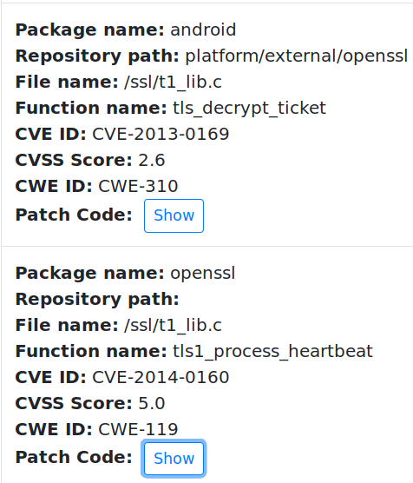
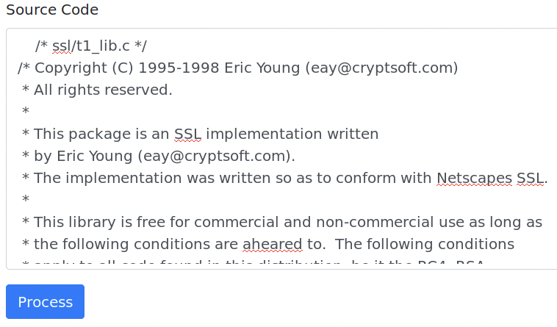
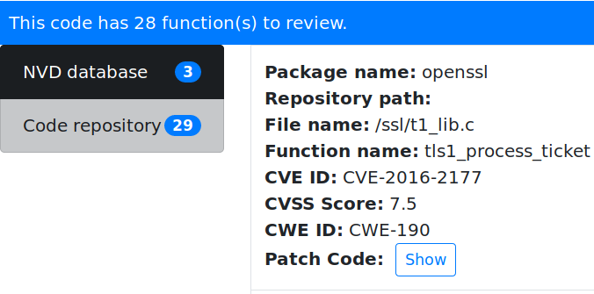

Example Result: Code Matched 3 Vulnerabilities
Souce Code:
30

Slide 31
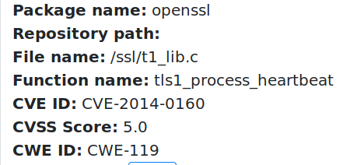
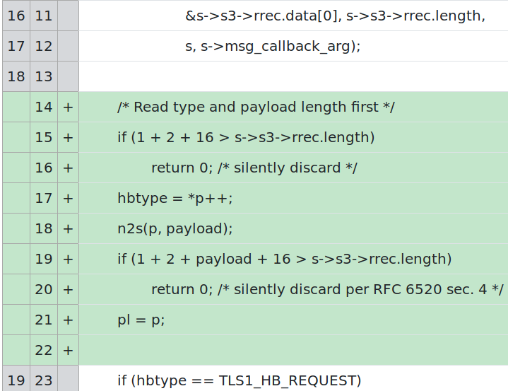
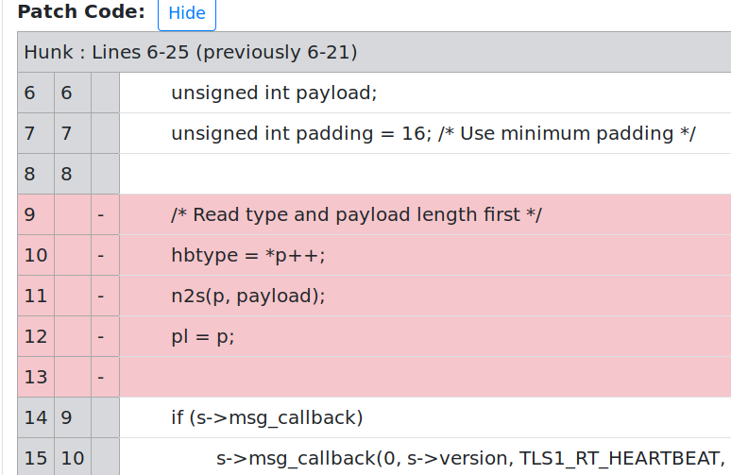
Example Result: A Matched Vulnerability And Its Fix
31

Slide 32
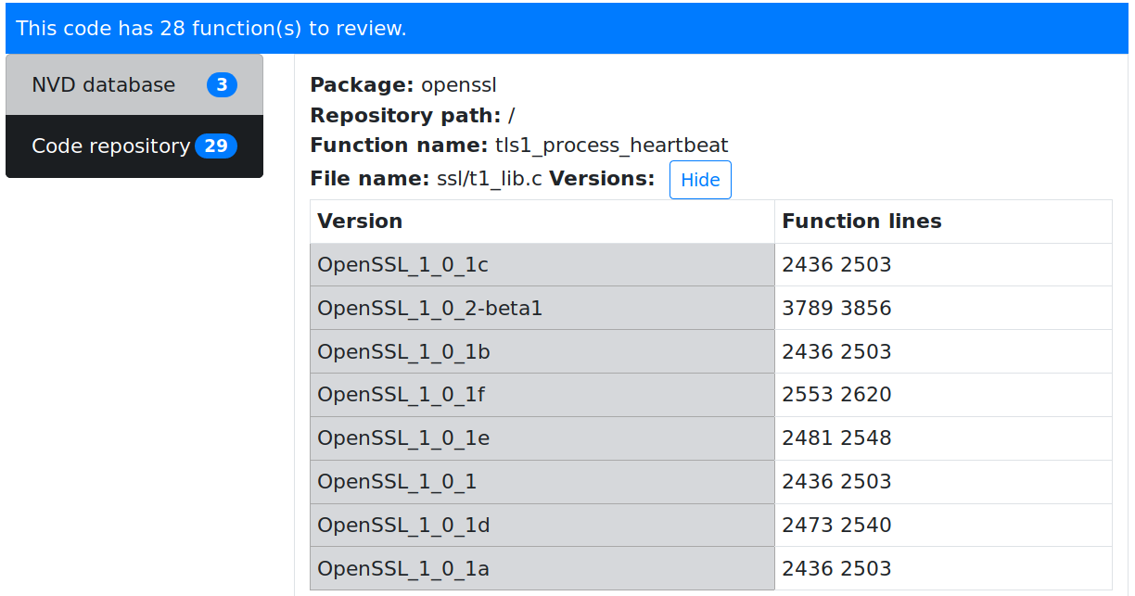
Example Result: Versions That Are Vulnerable
32

Slide 33
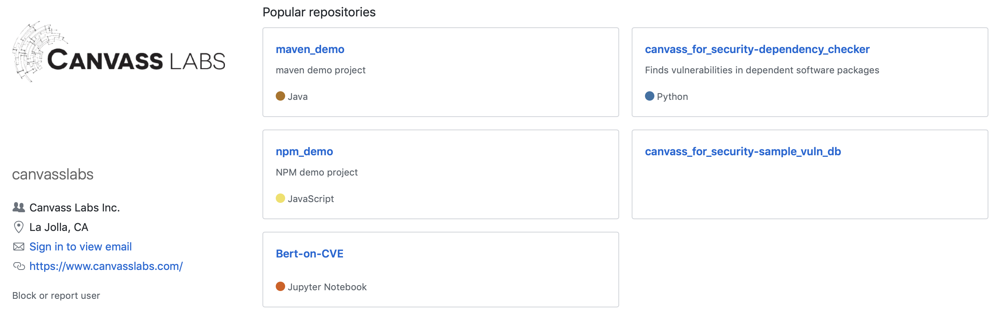
https://github.com/canvasslabs
33

Slide 34
Where is my Code Vulnerable: Matching CVEs and Source Code
David A. Barrett & Peter Shin, Canvass Labs
david.barrett@canvasslabs.com
peter@canvasslabs.com
https://www.canvasslabs.com

